Slide 1

• Nanosensors for single molecule detection

Slide 2
Why nanosensors?
Applications: health and environment
High sensitivity and precise quantitative evaluation required.
The most powerful approach consists in single molecule detection.
Nanowires, nanotubes and nanopores are proven to be very effective for single molecule detectors.
Stochastic analysis required in order to retrieve very
small molecule concentrations.

Slide 3
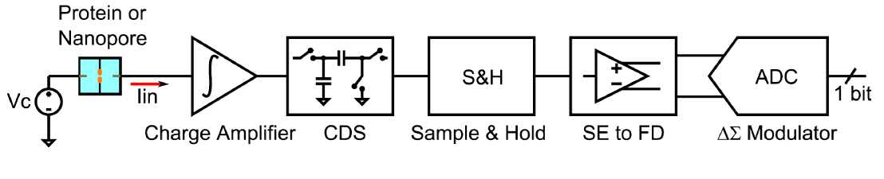
Sensing approach
A single-ended charge amplifier is followed by a Correlated Double Sampling (CDS) circuit followed by a S&H.
120μs integration time; 8μs reset time.
A switch is used to set the value of the feedback capacitor: full-scale ranges: ±200pA and ±5nA.
CDS output converted from single-ended to fully-differential and applied to a 1st-order ΔΣ modulator.

Slide 4
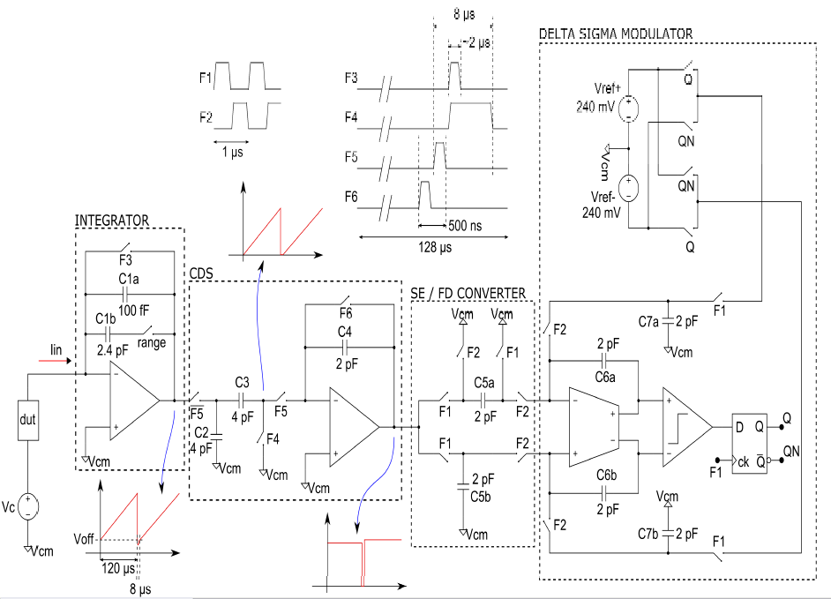

Slide 5
Results
Using 240mV reference voltages and a clock period of 1Mhz, it is possible to set full scale ranges of 200pA and 5nA depending on the input charge integrator feedback capacitor.
Prototype fabricated using 0.35µm CMOS process occupying 0.5mm² with power consumption below 23mW on a 3.3V supply.

Slide 6
Conclusion
A current amplifier has been designed to be embedded with nanosensors structures for enhancing SNR and increasing data acquisition rate.
With noise floor below 150fA_{rms} at 1kHz, is it sufficiently low to allow single molecular event readout.
The proposed approach allows future realization of small and cheap biosensors based on stochastic sensing.

